Slide 1

Creator: Hiệp Vũ
Phan Sơn

Slide 2
IPv6 – What is it and why?
IPv6 (Internet Protocol version 6): New IP addressing Structure
128-bit address represented as 32 hex digits
Address is composed of 8 groups of 4 hex digits
Provide 2²¹⁸ IP addresses
IPv6 is a “separate Internet” than the IPv4 Internet

Slide 3
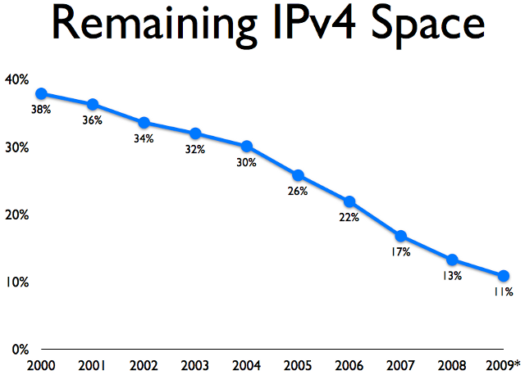
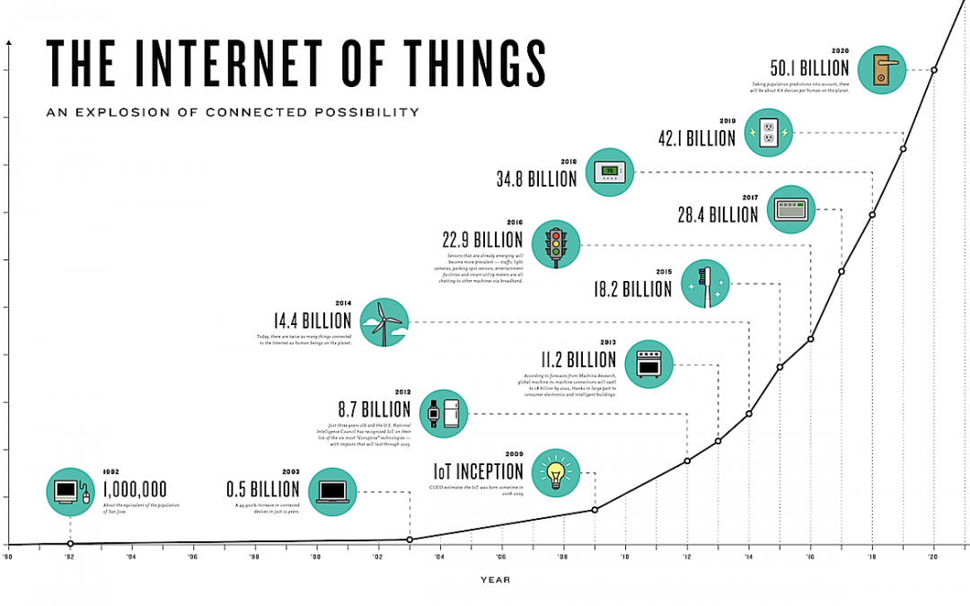
Why have to be IPv6?
The Internet need room to grow

Slide 4
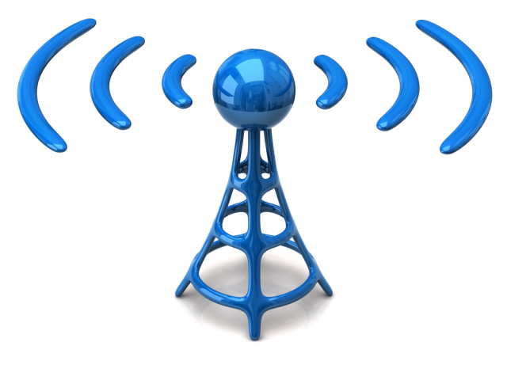
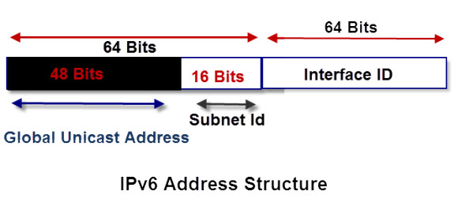
Benefits and improvements
Does not use Broadcast messages
Unicast Multicast Anycast
Simple and efficient addressingstructure
Integrated security and better support for Quality of Service

Slide 5
Address Abbreviation
Rules :
Drop leading zeros
A group of 4 zeros can be replaced with a single zero
Contiguous groups of zeros can be replaced with a
:: but that can only done once in an address
Loopback:
IPv6 loopback is ::1

Slide 6
Something we should know about IPv6
Ipv6 addresses are 128-bit length
The prefix for a link-local address is FE80
The first 64 bits represent the network and the last 64 bits represent the host
IPv6 host address subnet masks are always /64
An automatic host address can be assigned automatically or manually
To get on the internet a computer needs a link-local IPv6 address and a global IPv6 address
The world is still transitioning to IPv6 and will continue to run IPv4 and IPv6 side by side

Slide 7
IPv6 and VietNam

Slide 8
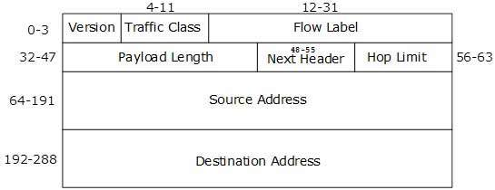
IP Headers

Slide 9
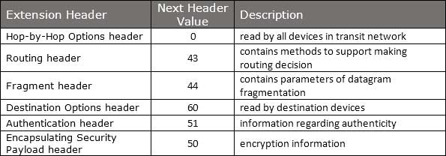
Extension Header

Slide 10

IPv6 Communication
IP address acquired = How??
DHCP ,manual configuration
Host
Host

Slide 11

ARP has been replaced by ICMPv6 Neighbor Discovery Protocol.
ARP
Neighbor Discovery Protocol

Slide 12
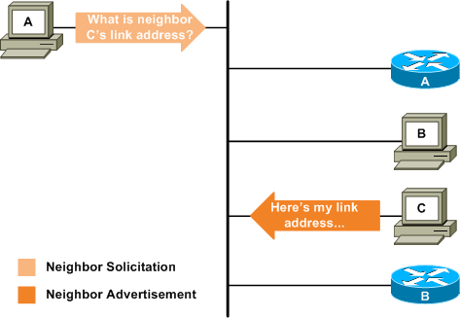
Neighbor Discovery Protocol
DAD
(Duplicate Address Detection)

Slide 13
IPv6 - Subnetting

Slide 14
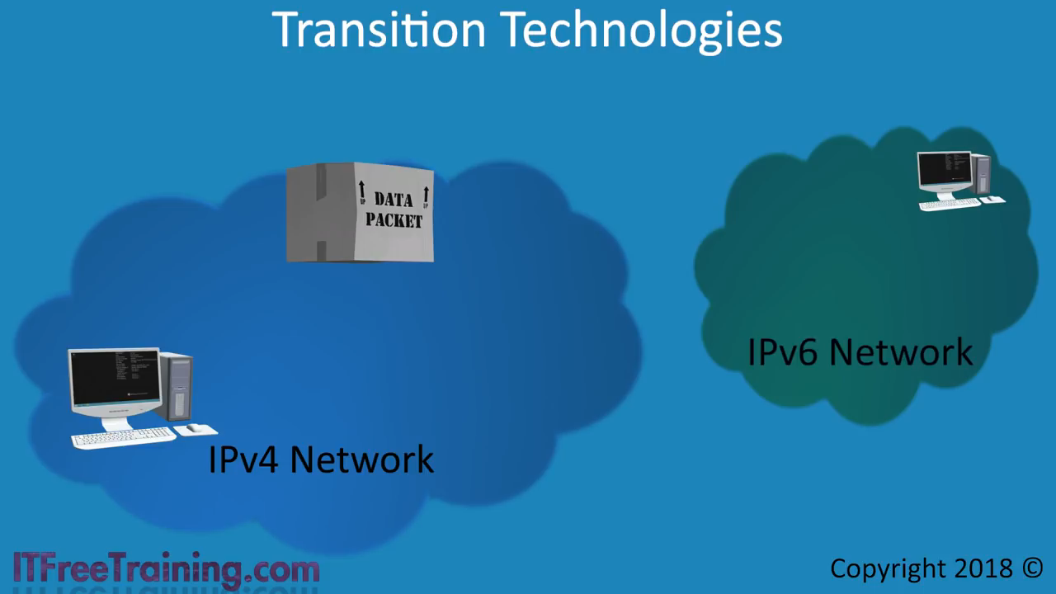
IPv4 Commute IPv6

